Slide 1


Forecasting and Analysis of Renewable Energy
Student - Gosset Group
Group Members-
Anuj Hydrabadi
Nayan Nilesh
Nitin Vinayak Agrawal
Debabrata Chaudhary
Kartik Agrawal
Divyam Sharma
Aryamick Singh
Rohan Tibrewal

Slide 2
Aim
The aim of the assignment is to analyse and, if possible, forecast the various weather parameters related to wind and solar energy for the data given.
The data is based in the Charanka Solar Park (Gujarat), for the period of 2000-2010. Data for various parameters is given for every hour in the given period.
The variable relevant to solar energy is GHI (Global Horizontal Irradiance), while the variable for wind energy is Wind Speed.

Slide 3
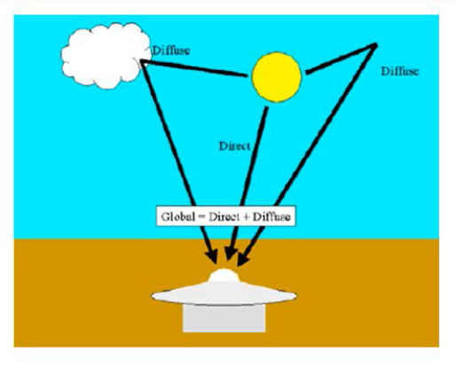
Global Horizontal Irradiance = Direct Normal Irradiance + Diffuse Horizontal Irradiance

Slide 4
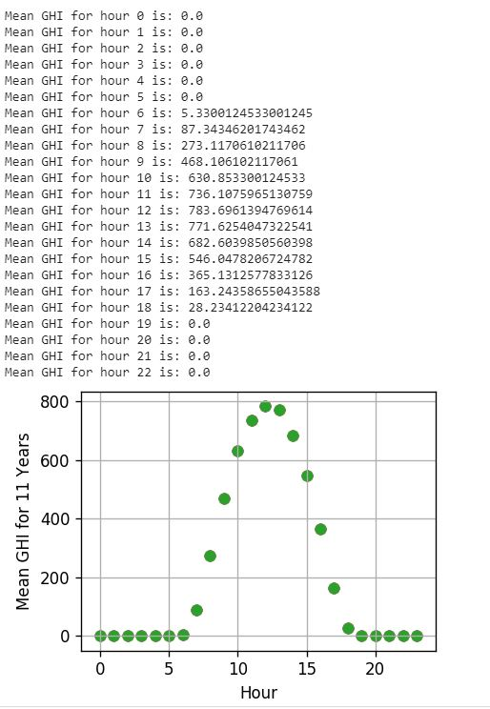
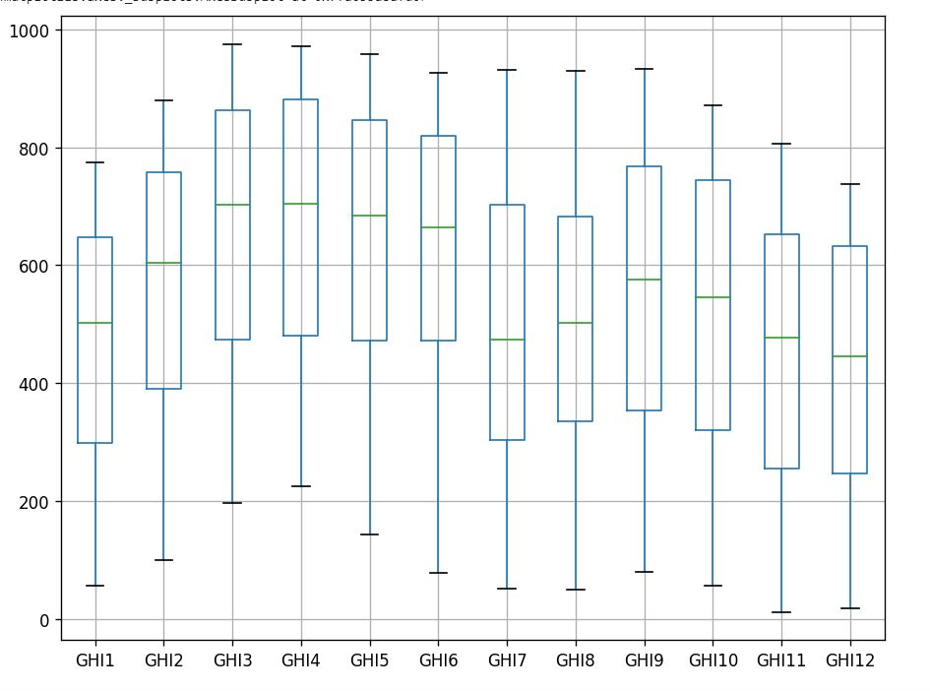
Descriptive Statistics - GHI

Slide 5
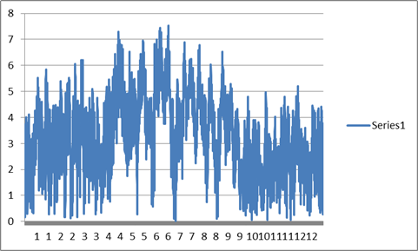
Descriptive Statistics - Wind Speed
About data:
The graph on the left shows the time-series data of wind speed over the entire year of 2000. It’s depicting the variations w.r.t. 12 months (x-axis).
We can observe from the plot that the average wind speed is increased during the months of May (5), June (6) & July(7) primarily due to pre-monsoon and monsoon winds. (fast moving annual winds accompanied by rain)

Slide 6
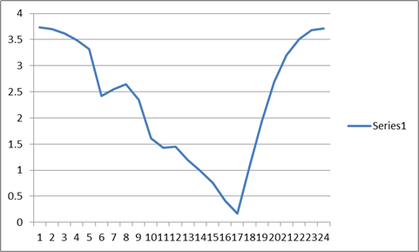
Descriptive Statistics - Wind Speed
The graph on the right shows the diurnal (i.e. all day) variations of wind speed. The speed increases after the sunset time. (around 5-6 PM ie 1700-1800 hrs)
This can be attributed to sea-breeze effect, according to the geographical location of power plant. (wrt Arabian Sea)

Slide 7
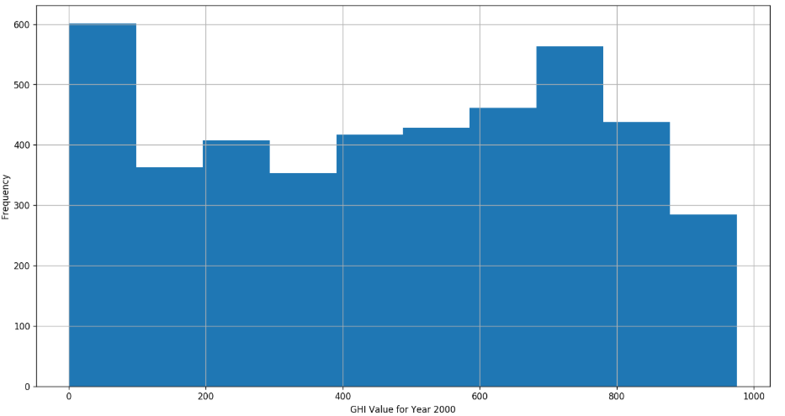
Identifying Distribution
Using Kolmogorov-Smirnov Test, which compares our distribution against a particular theoretical distribution, we have identified the following distributions - GHI - no particular distribution identified (p-value ~ 0 for every distribution tested).
GHI histogram for Year 2000.

Slide 8
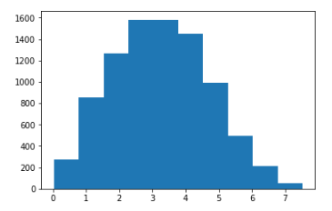
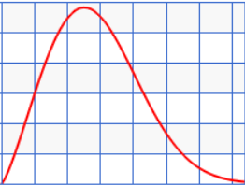
Identifying Distribution
Wind speed - Weibull distribution with parameters (obtained using Maximum Likelihood Estimation - MLE)
Weibull Parameters
Shape | 2.41
Scale | 3.66
For goodness of fit test, we considered:
Normal, Weibull, Gamma, Exponential, Beta & Lognormal distributions
Wind Speed Histogram for Year 2000

Slide 9

Weibull Distribution
The pdf of Weibull random variable x is given as:
λ : Scale parameter; determines the “spreadness” of distribution
k: Shape parameter; determines the skewness of distribution
It has distinguished advantage over normal distribution since it can accomodate skewness which could be seen in the wind speed data. (Normal distribution was the 2nd best distribution in the fitness test)

Slide 10
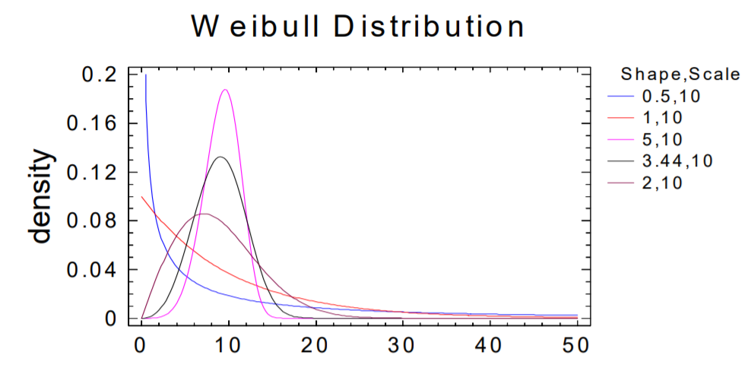
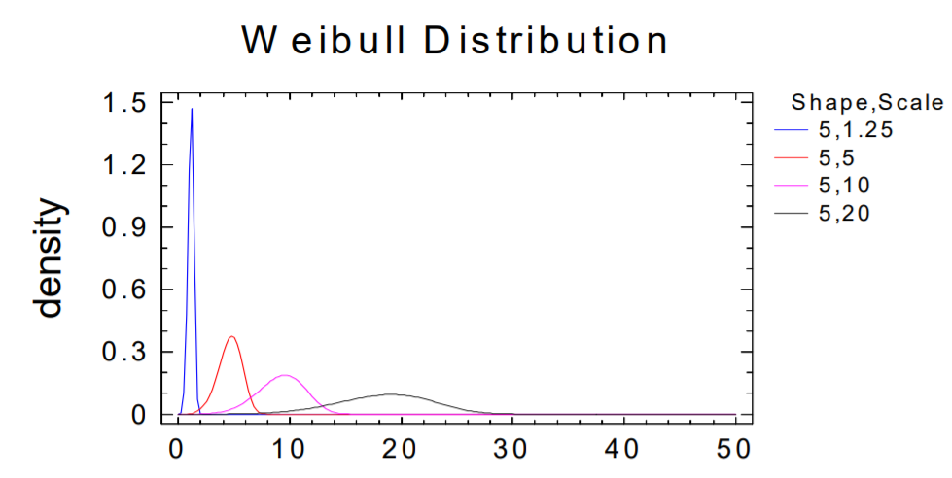
Weibull Distributions for Varying Shape & Scale Parameters
← Scale constant, varying shape parameter
Shape constant, varying scale parameter →

Slide 11
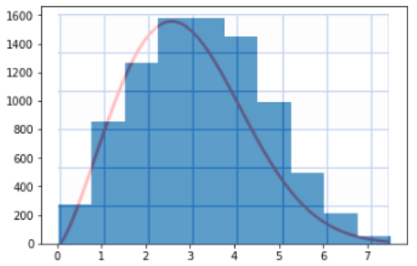
MLE
We were able to apply Maximum Likelihood Estimation as our test distribution was continuous in nature.
Also, since the number of parameters were few (2 for Weibull distribution), results obtained were fairly good as the distribution was fitting the data accurately (shown below).

Slide 12
Time Series Analysis for Wind Speed data
The first step is to check for stationarity in data.
Augmented Dickey-Fuller Test
Null Hypothesis (H0) : Data is non-stationary.
Alternative Hypothesis (H1) : Data is stationary.
P-value obtained is of the order 10^(-8), or approximately 0. Hence, we can conclude that the data is stationary and reject the null hypothesis.

Slide 13
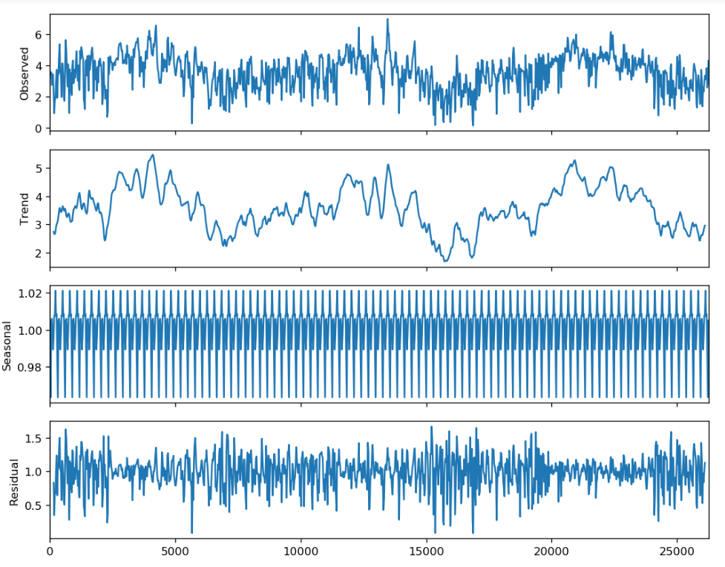
Dividing into various components - trend, seasonal, residual
3 years wind speed data (yrs 2000-02)

Slide 14
Components of Time Series
The wind speed changes with the change in weather and this change doesn’t follow any trend nor is it constant. Thus, the seasonal component is not independent of time. So, we have chosen Multiplicative model for the decomposition. (although very similar results were obtained with additive model too)
Trend: There’s no clear trend in the data over the years. Every year, a period is observed with a positive trend when monsoon season is approaching and a dip after the season & this cycle is repeated every year.
Seasonal: It can be seen to follow periodic variations throughout the year similar to the wind speed variations from maximum to minimum over a day & across a month.
Residual: This component is random in nature & symmetric about x axis indicating normal behaviour which was expected.

Slide 15
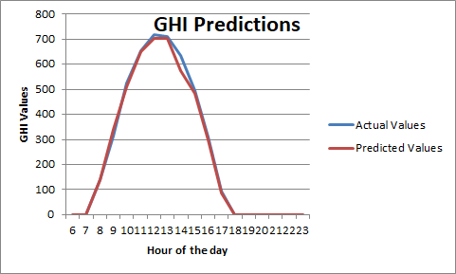
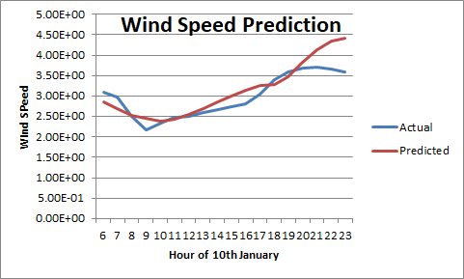
Predicted Values based on Simple Averaging
As the data is stationary with only seasonal components, so we have taken the average of a 10 day window of the hour for which prediction is to be made for the past 10 years while predicting for year 2011.

